Slide 1


TASK 3 | Mentorness Data Analytics Internship
Hotel Aggregator Analysis
A TABLEAU PROJECT
Christian Nico Gayo
MIP-DA-07

Slide 2

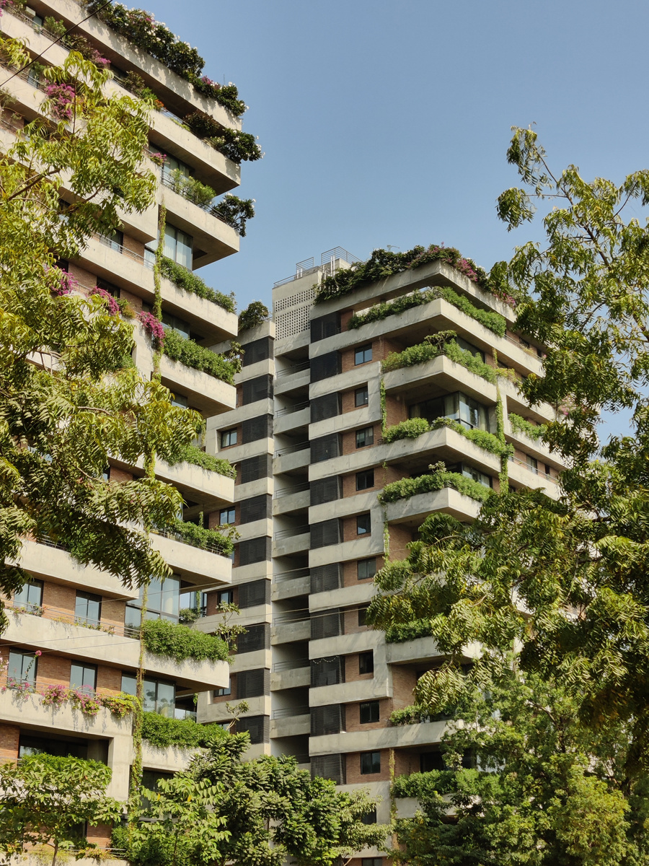
Hotel Aggregator Analysis
Rationale

Slide 3
Rationale
Hotels and Airbnbs significantly contribute to local and international tourism economies, driving substantial revenue and creating numerous jobs.
In such a competitive market, leveraging data analysis is essential for business growth. By analyzing hotel listing datasets, companies can uncover valuable insights into trends, patterns, and key performance metrics. This helps optimize pricing strategies, enhance availability, and improve service quality. Understanding host characteristics and review scores enables targeted improvements that elevate the guest experience. Ultimately, a data-driven approach leads to increased profitability and long-term success in the dynamic hospitality industry.

Slide 4

Hotel Aggregator Analysis
Project Overview

Slide 5
Project Overview
In an industry where hotels and Airbnbs significantly impact the global economy, data analysis becomes crucial for driving business growth.
As a data analyst intern, the task is to perform a comprehensive hotel aggregator analysis on a detailed dataset of hotel listings. Utilizing Tableau, this analysis will uncover trends, patterns, and key metrics such as pricing, availability, host characteristics, and review scores.
The goal is to derive actionable insights that enhance the quality and competitiveness of these listings, ultimately contributing to the success and growth of the business.

Slide 6

Hotel Aggregator Analysis
Project Objectives

Slide 7
Project Objectives
Geographical Insights
- Visualize the distribution of listings on a map to identify popular neighborhoods.
- Explore the geographical concentration of listings and host locations.

Slide 8
Project Objectives
Pricing and Availability Analysis
- Analyze pricing trends based on property types, room types, and accommodation capacity.
- Investigate the availability of listings over time and identify peak periods.

Slide 9
Project Objectives
Host Performance
- Evaluate host characteristics, including superhost status, response times, and verification methods.
- Explore correlations between host attributes and listing performance.

Slide 10
Project Objectives
Review Scores and Guest Satisfaction
- Examine review scores and their impact on overall listing performance.
- Identify areas for improvement based on specific review categories.

Slide 11
Project Objectives
Property Type and Room Analysis
- Analyze the distribution of property types and room types.
- Explore trends in the popularity of specific accommodation setups.

Slide 12

Hotel Aggregator Analysis
Dataset Description

Slide 13
Dataset Description
1. id: Unique identifier for each listing.
2. listing_url: URL of the listing on the hotel aggregator platform.
3. scrape_id: Identifier for the data scraping event.
4. last_scraped: Date of the last data scrape.
5. source: Source of the listing information.
6. name: Name of the listing.
7. description: Description of the listing.
8. neighborhood_overview: Overview of the neighborhood where the listing is located.
9. picture_url: URL of the listing's picture.
10. host_id: Unique identifier for the host.
11. ... (and many more columns capturing details about hosts, location, property type, room details,
amenities, pricing, availability, reviews, and other relevant information)

Slide 14

Hotel Aggregator Analysis
Geographical Analysis

Slide 15
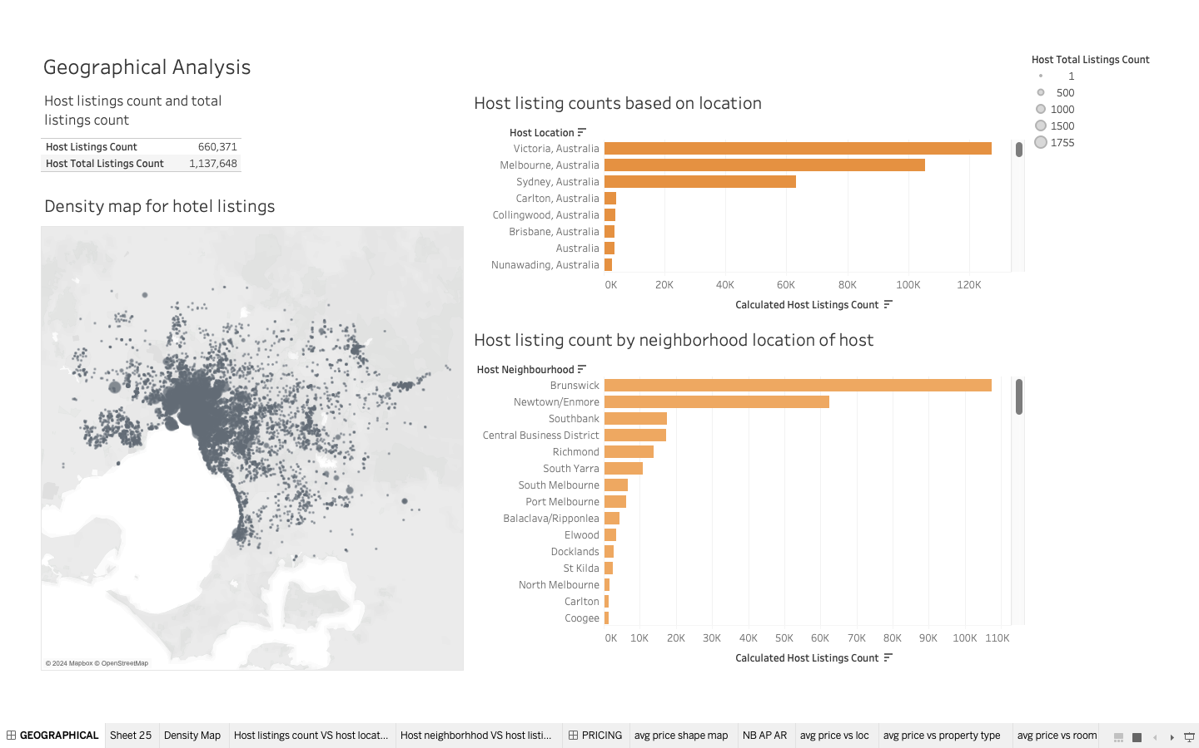

Slide 16
Geographical Analysis
FINDINGS
1) Host counts have reached 660, 371.
2) Total host listings have reached 1, 137, 648.
3) Victoria, Australia has the highest listing count among all other locations.
4) Brunswick is the neighborhood that has the highest listing count.

Slide 17

Hotel Aggregator Analysis
Pricing and Availability Analysis

Slide 18
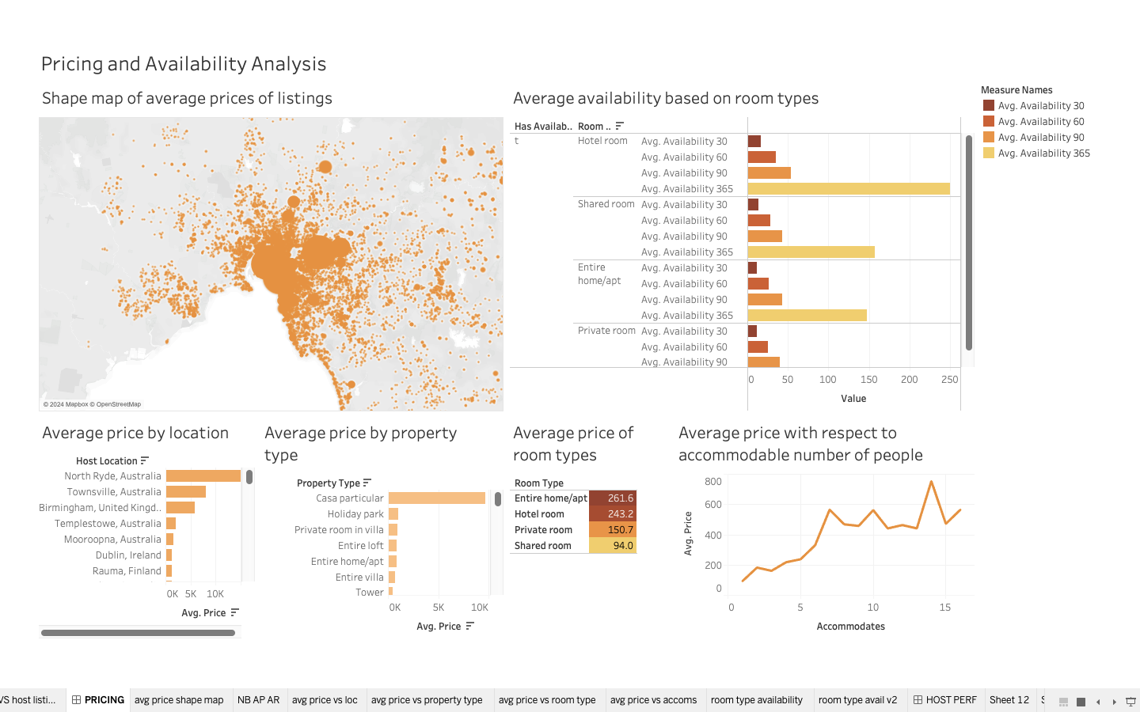

Slide 19
Pricing and Availability
Analysis
FINDINGS
1) Listings from North Ryde, Australia have the highest average prices, exceeding USD 10,000.
2) Casa particular listings have the highest average prices, exceeding USD 10,000.
3) Entire rooms/apartments are the most expensive room types with an average price of USD 261.6.
4) Shared rooms are the least expensive room types with an average price of USD 94.

Slide 20
Pricing and Availability
Analysis
FINDINGS
5) As the number of accommodable people increase, the average price for a listing also increases. Interestingly, listings that can accommodate 14 people are way more expensive than listings that can accommodate 15 people and more.
6) Hotel rooms have the highest availability all-year round.

Slide 21

Hotel Aggregator Analysis
Host Performance

Slide 22
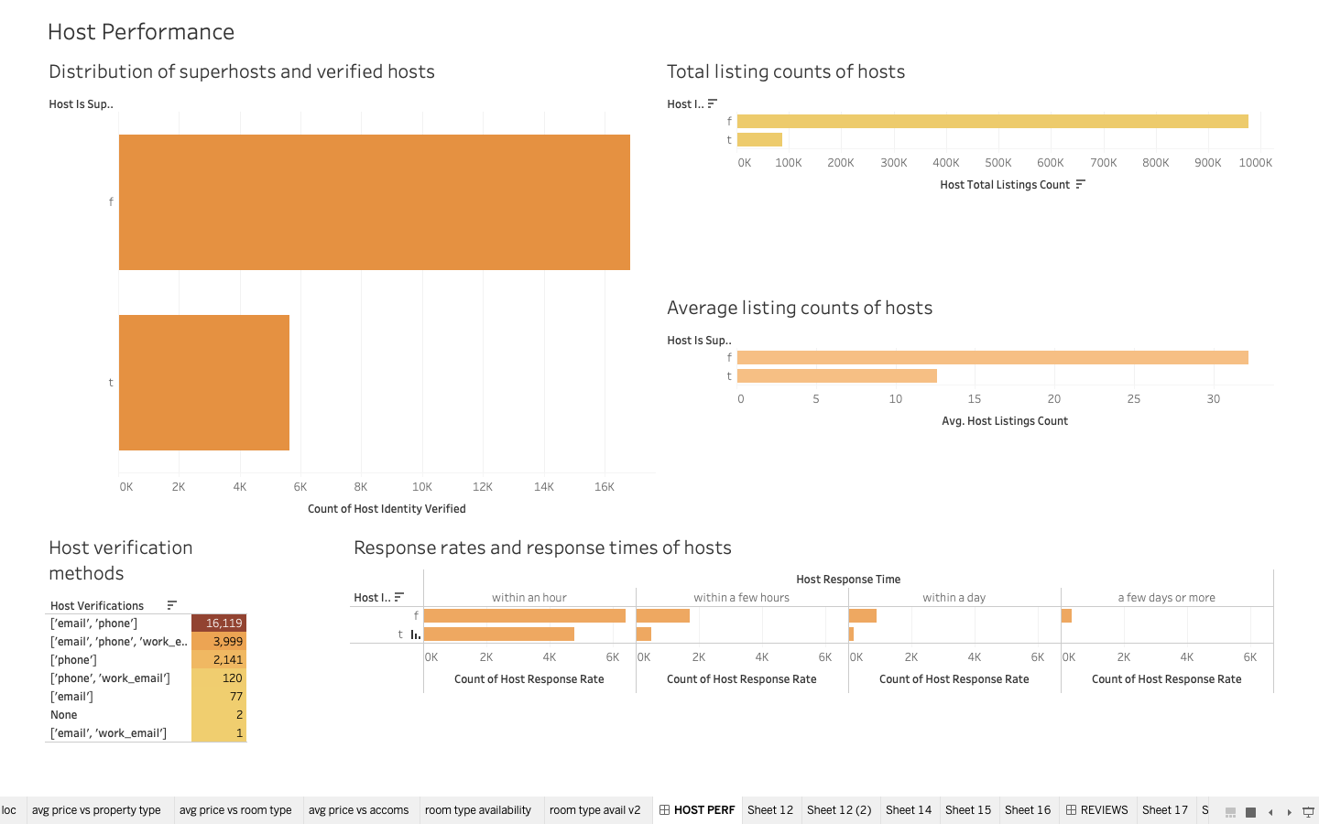

Slide 23
Host Performance
FINDINGS
1) Non-superhosts are more prevalent than superhosts. Interestingly, there are more verified non-superhosts than superhosts.
2) Non-superhosts have more listings than superhosts.
3) The average listing count for non-superhosts are higher that superhosts.
4) Email and phone are the most used methods of verification for all hosts.
5) Non-superhosts are more responsive than superhosts.
6) Hosts typically respond to inquiries within an hour.

Slide 24

Hotel Aggregator Analysis
Review Scores and Guest Satisfaction

Slide 25
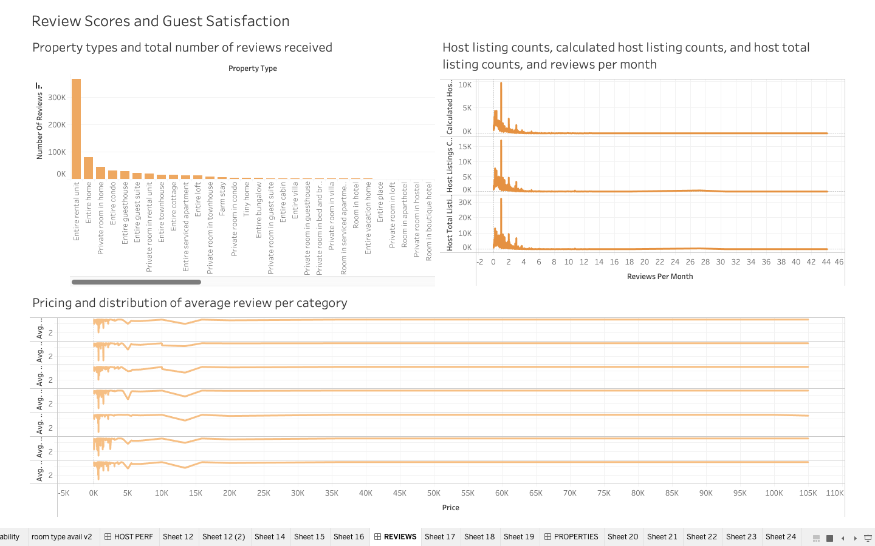

Slide 26
Review Scores and Guest Satisfaction
FINDINGS
1) Entire rental units are the most reviewed property types.
2) Reviews received per month is inversely proportional to host listing counts. Hosts with more listings receive lesser reviews per month. Hosts with lower listing counts receive more reviews per month.
3) Price is directly proportional to average review rating. As the price of the listing goes up, the average review rating also goes up.

Slide 27

Hotel Aggregator Analysis
Property Type and Room Type Analysis

Slide 28
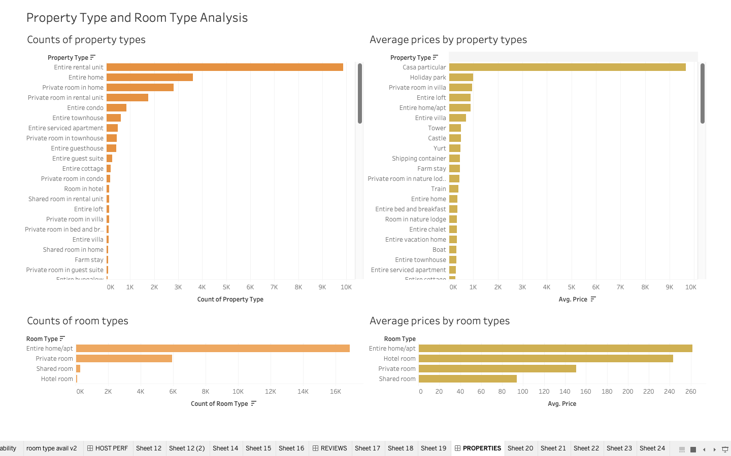

Slide 29
Property Type and Room
Type Analysis
FINDINGS
1) Entire rental units are the most prevalent property type in terms of count.
2) Casa particular units have the highest average prices, breaching the USD 9,000 price point.
3) Entire home/apartment units are the most prevalent room type in terms of count.
4) Entire home/apartment units have the highest average prices at USD 260. This is followed by hotel rooms, private rooms, and shared rooms.

Slide 30

Hotel Aggregator Analysis
Conclusions

Slide 31


Conclusions
By leveraging Tableau to analyze hotel listing datasets, the project provides actionable insights that can significantly enhance pricing strategies, availability, and service quality.
The comprehensive analysis of key metrics and trends within the dataset enables targeted improvements, driving overall business growth and competitiveness in the hospitality industry.
This data-driven approach ensures that hotels and Airbnbs can adapt to market demands effectively, resulting in increased profitability and sustained success.

Slide 32
TASK 3 | Mentorness Data Analytics Internship
Hotel Aggregator Analysis
A TABLEAU PROJECT
Christian Nico Gayo
MIP-DA-07

